Slide 1
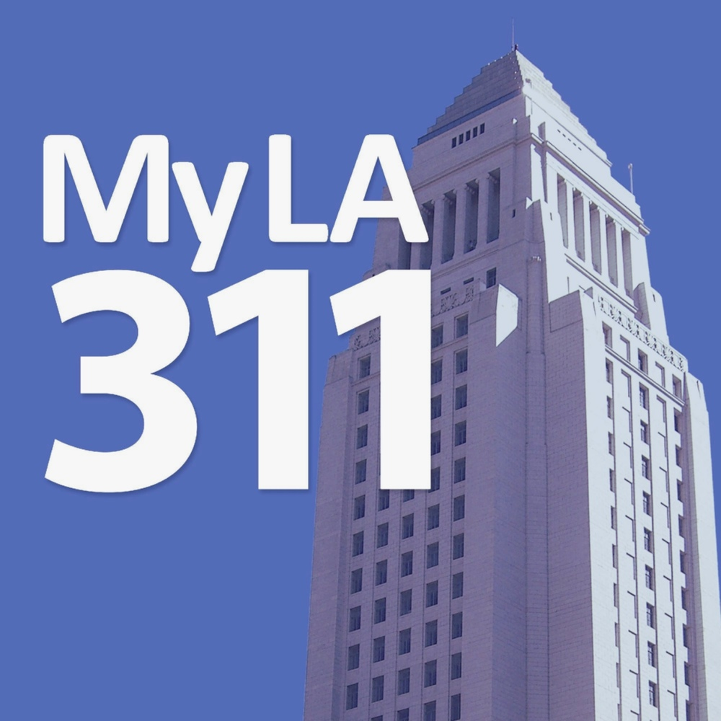


An Exploratory Data Analysis
311 Call Center Data,
City of Los Angeles
By Team Welikedata
Adeesh Goel
Bharadwaj Kachapuram
Hassaan Khalid
Nate Cohn
Paige Schwimer
Saavi Gupta

Slide 2
Agenda
Overview of Recommendations
Key Issues and Support Analysis – Visualizations through R
Summary: In a Nutshell, the Key Actionable Insights

Slide 3
Key Insights
Issues Identified
Recommendations
Inefficient Agent Utilization
IVR/Call Center Optimization
Slower Response Rate for App Requests
Training and Performance Management
Under-utilization of 311 App
ATL and BTL Marketing Initiatives
Graffiti Problem
Graffiti Legalized Wall
(currently only one in LA)
Note: ATL- Above The Line refers to promotional activities done at a macro level. Eg: Radio, TV ; BTL- Below The Line Marketing refers to promotional activities done at a micro level minus mass media. Eg: Email Marketing, Telemarketing

Slide 4
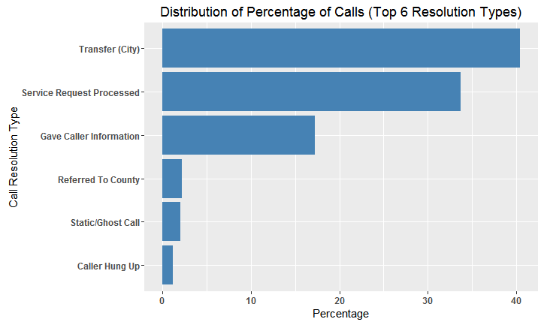
Support Analysis
Issue 1: Inefficient Agent Utilization
Validated through calling 311.
Single level IVR – only language selection
Phone no. given for contacting sanitation department
More in-depth IVR allowed by training agents on skills and mapping VDN skill mapping
Direct re-routing of calls through VDN
Deploy Afiniti, a McKinsey Solution

Slide 5
Support Analysis
Issue 1: Inefficient Agent Utilization
$70 million incremental revenue annually for T-Mobile and 3% increase in collections revenue
6.5% increase in sales revenue for Caesars along with 30000 incremental reservations
$100 million incremental annual revenue for Sprint
47000 new customers for Sky UK along with 2% decrease in the churn rate
4% increase in sales conversion rate for Kwik Fit
6% increased conversion rate for Ageas

Slide 6
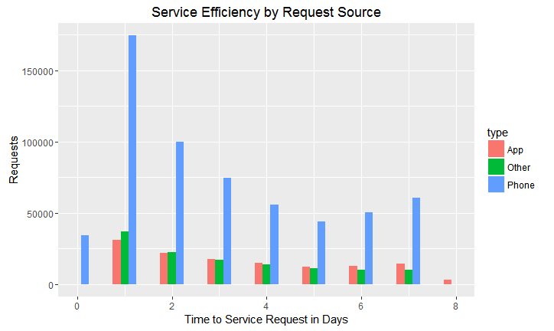
Support Analysis
Issue 2: Slower Response Rate for App Requests
Most requests made by phone are resolved on the first day. However, requests made through apps are more likely to have delayed resolution.
Train the agents to respond to app complaints.
Establish training programs, KPIs, and performance management systems to gauge performance over resolution of app requests separately.

Slide 7
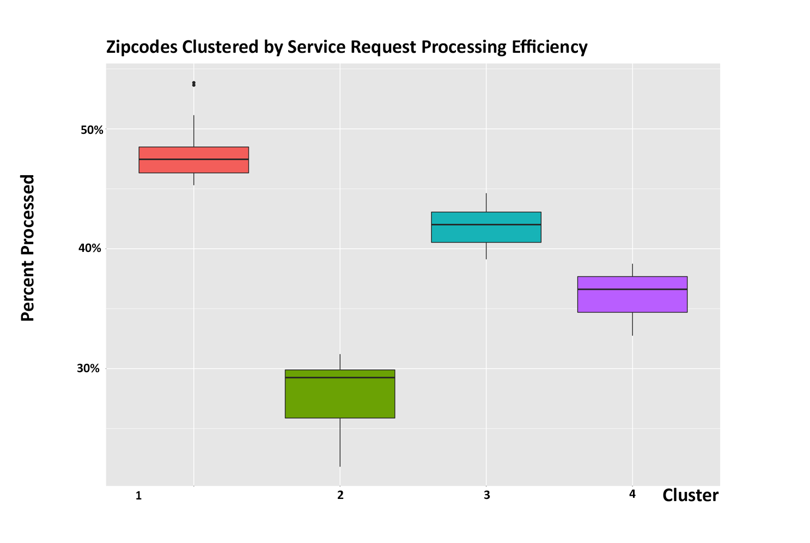
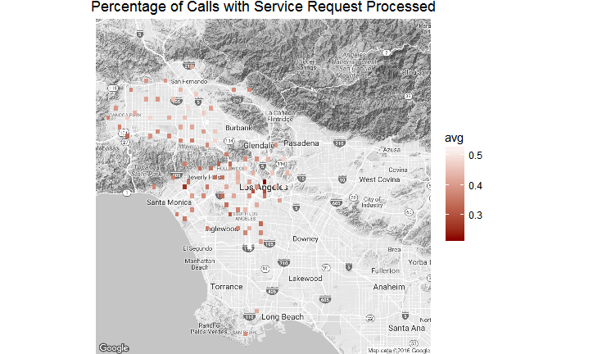
Support Analysis
Issue 2: Slower Response Rate for App Requests
Some clusters of zipcodes have a lower percentage of service requests processed overall

Slide 8
Recommendation
Issue 2: Slower Response Rate for App Requests
We need to ensure that essential requests such as bulky items or any other important requests that come in through the app are responded to quickly.
Without suitable service, the app will not retain users. Creating efficiencies within the call center will create space for responding to app requests.
Set KPI’s and train the personnel to decrease processing time of app service requests

Slide 9
Support Analysis
Issue 3: Under-utilization of 311 App
Higher no. of Graffiti requests over the week
Low percentage (5%) trend shift for reporting graffiti from call to app after app introduction in April 2013
Tap on the App potential as Increase in graffiti removal requests with introduction of 311 app shows previously unmet needs
Aggressive ATL and BTL marketing initiatives

Slide 10
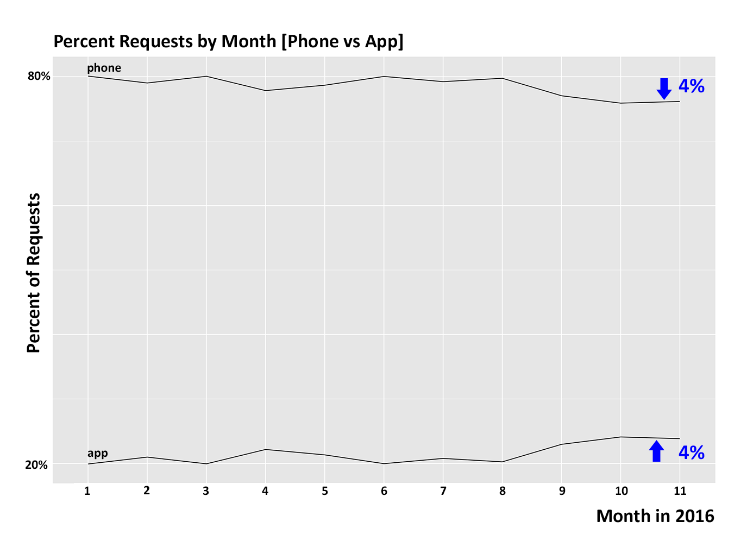
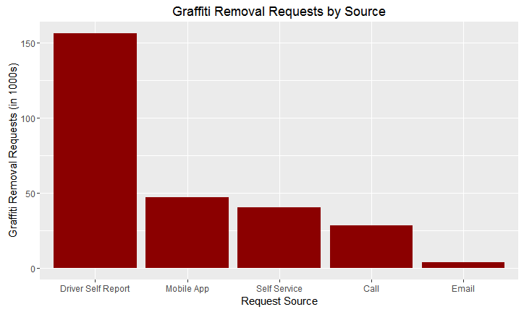
Support Analysis
Issue 3: Under-utilization of 311 App
In comparison to overall usage, mobile app is used more for reporting graffiti
Increase in app use over 2016 suggests opportunity for further growth

Slide 11
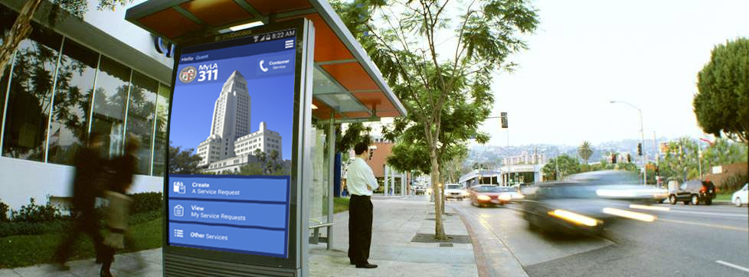
Recommendation
Issue 3: Under-utilization of 311 App
Promote app throughout Los Angeles. For example on bus stops, busses, social media or public radio.
Run water waste reduction campaign utilizing the app’s photo capability and report function

Slide 12
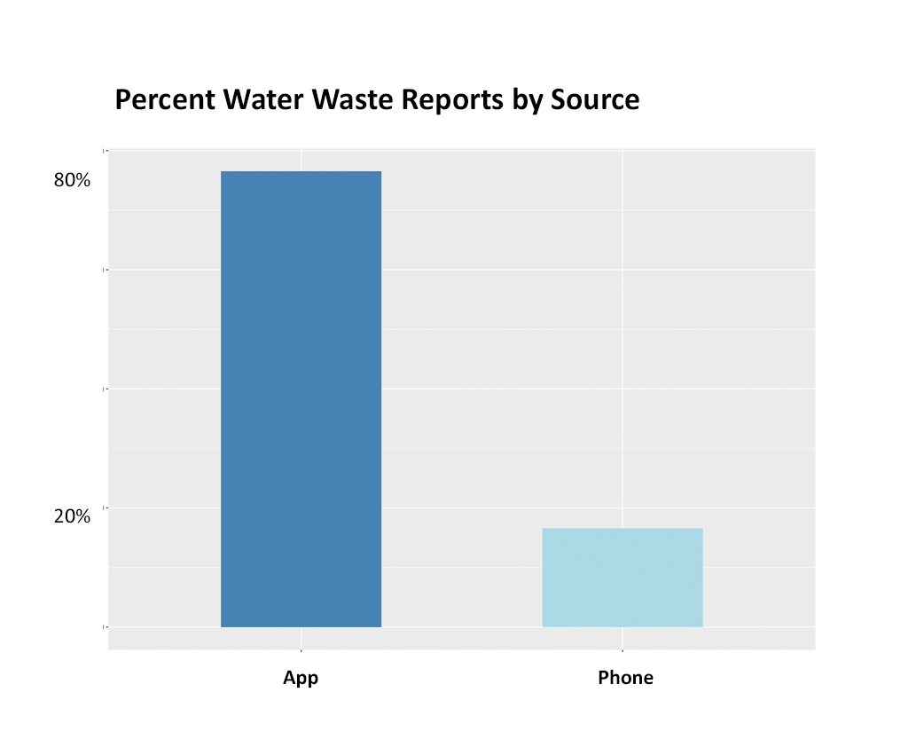
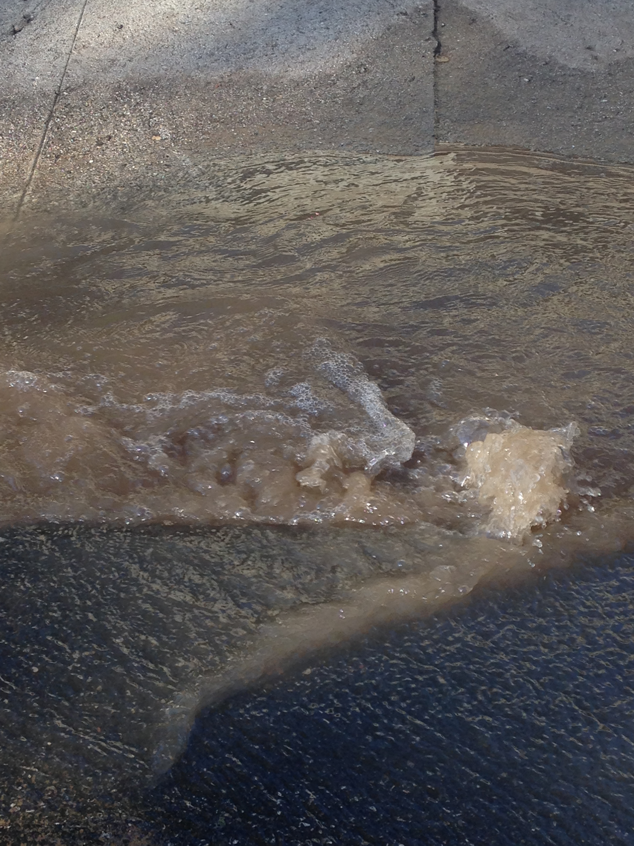
Recommendation
Issue 3: Under-utilization of 311 App

Slide 13
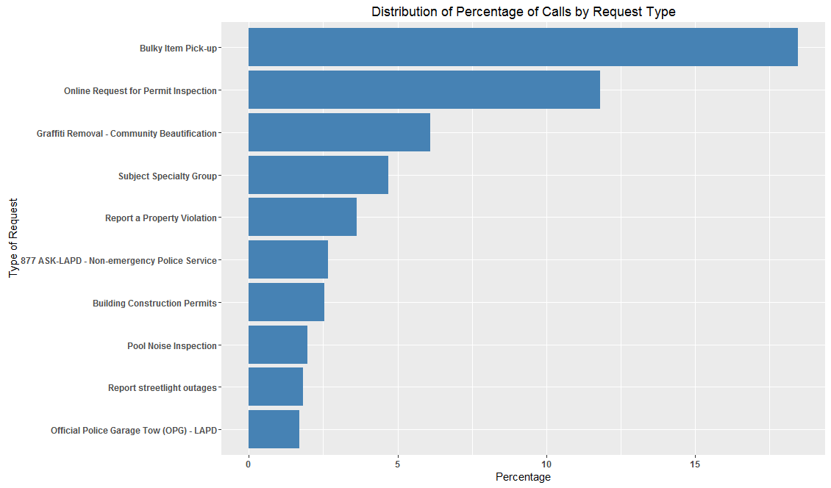
Support Analysis
Issue 4: Graffiti Problem
Third highest issue identified as graffiti problem
Increase in reporting of graffiti post launch of App thus, indicating high instances of graffiti which remained unreported previously
Vancouver Success Story
Legalizing graffiti in pre-ordained areas helped Vancouver alleviate the graffiti spread in the rest of the city

Slide 14
In a Nutshell…
A robust and detailed IVR system to counter the issue of under-utilization
Response time is much slower for app requests
It is important to support app requests for essential services, especially if trying to increase app use
Create efficiencies through training throughout system to allow space for app requests
There is much opportunity for growth in app use
Advertise in Los Angeles
Use app functionalities in campaigns
Combat the graffiti problem through more legalized walls (Vancouver: An exemplary story)

Slide 15
Thank You! Any Questions?

